Slide 1
What’s on in Chapel?
Our Chapel aims to be a welcome space for everyone. All college members and their guests are invited to attend Chapel services in Hertford College. Many who attend would not profess a faith, but come for the beauty and tradition of our services. The services are Anglican in character but we welcome worshippers from every denomination, as well as people of any faith or no faith.
REGULAR CHAPEL SERVICES
MUSIC
Sundays 5:45pm – Choral Evensong (BCP)
Our principal service, with guest speakers. Followed by drinks.
Tuesdays 9pm – Compline by Candlelight
A short plainchant service each Tuesday evening. Come early to set up & light candles.
Thursdays (odd weeks) 6pm – Eucharist
A short, informal, said service of Holy Communion, usually with an instrumental interlude or Taizé chant.
Wednesday lunchtimes
Hertford College Music Society recitals. Free, with a retiring collection for the HCMS fund.
Friday 5:30-7pm & Sunday 4-5:30pm
Choir practice – contact the Organ Scholars William Jeys and James Norton.
OTHER CHAPEL ACTIVITIES
EXAM CARNATIONS
Carnations will be available in chapel during the exam period. Collect yours and light a candle, use the pebble pool, or write your exam on the prayer board.
MAY DAY MADRIGALS
Sung by the choir from Hertford bridge. 8am on Monday 1st May (2nd week).
ROMAN CATHOLIC MASS
This term’s Mass takes place at 6pm on the Monday of 3rd week (8th May), followed by a free supper. Contact Jenny Grehan-Bradley for further details.
CHARITY
OXFORD EVENTS
Evensong offerings this term will support the work of
BLAP
(Blackbird Leys Adventure Playground)
providing after-school and holiday provisions for 8-13 year olds. This charity was nominated by Bursary Colleague Ewa Gluza
Pride Service
There will be a brief act of worship at University Church at 10:30am on Saturday 3rd June (Saturday of 6th week) prior to the Pride Parade. Everyone is welcome.
The Annual Interfaith Friendship Walk
will take place on 15th June, Thursday of 8th Week. It starts at the synagogue in North Oxford and wends its way through the city. https://oxcof.org.uk/friendship-walk/

Slide 2
Evensong Preaching Series
‘Living Well’
.
1st Week | 23rd April
The Very Reverend Dr Jeffrey John
2nd Week | 30th April
The Reverend Dr Michael Ward
3rd Week | 7th May
Evensong with Confirmation
The Right Reverend Dr Graham Kings
4th Week | 14th May
The Right Revered Tony Porter
5th Week | 21st May
The Reverend Susannah Reide
6th Week | 28th May
Pentecost
Dr Keith White
Overlooked no more: Pandita Ramabai
7th Week | 4th June
Trinity Sunday
Ordinand Christina Peacock
8th Week | 11th June
Leavers’ Service
The Chaplain
EVENSONG PREACHING SERIES
“I’ve been wondering…” – Sundays at 5:45pm
College members and their guests are invited to join the Chaplain and preacher for drinks in the Old Library after the service.

Slide 3
EXPORING FAITHS
Hertford Christians
The Chaplain is always keen to talk to members of the college community with questions about faith issues.
For information on a range of interfaith opportunities, such as philosophy, the arts, and scriptural reasoning:
https://www.oxfordinterfaithforum.org/
Christian Union
C.U. meets weekly. Contact Enkhtamir Erdenebulgan for further details.
FAITH MATTERS

Slide 4
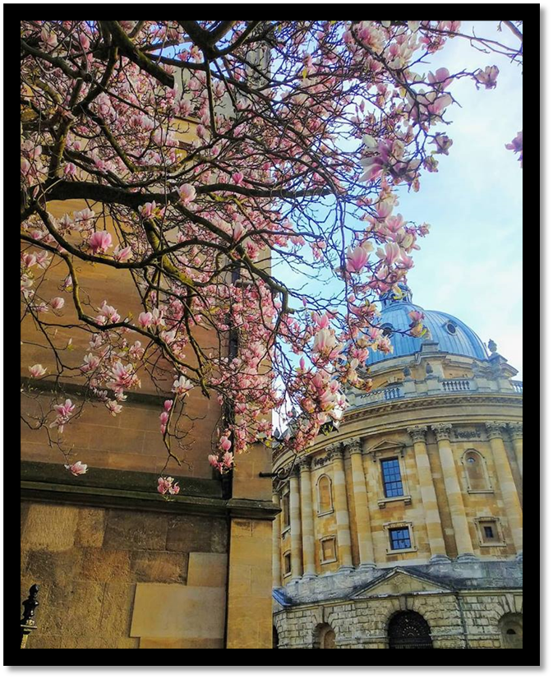
Photo courtesy of Ranjamrittika Bhowmik
The Chapel
TRINITY TERM 2023

