Slide 1
TIPS FOR SUMMER READING
Hertford College

Slide 2
Summer reading
Common questions are:
How much should I read?
What if I can’t focus?
What if I don’t understand?
Summer reading is an opportunity to prepare yourself for the greater freedom, independence, and intellectual challenge of learning at university.

Slide 3
How much should I do?
Do I have to read everything?
Read what is
accessible
achievable
useful

Slide 4
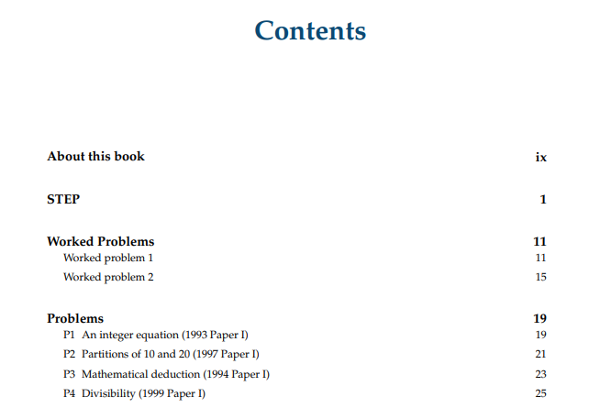
Worksheets
Tip: Locate the sections which help you complete any pre-course tasks.

Slide 5
Set texts
Familiarising yourself with set texts will take the pressure off during term.

Slide 6
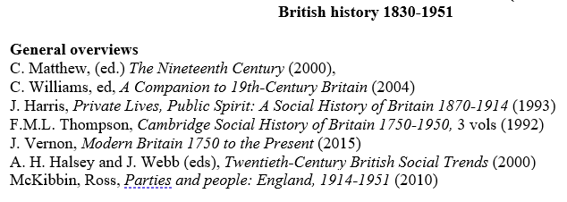
Long reading lists
Prioritise books which seem most relevant for your learning goals.

Slide 7
SpLDs
Some Specific Learning Difficulties can affect how much and how fast students read.
Less is more: decide your highest priority.

Slide 8
What if I can’t focus?
Break the work down into
a single task. Focus on one thing at a time.
short bursts of study: 25 minutes + 5 minute break.
steps.
☒ Do problem sheet.
Read problems and jot down what I know. (25 minutes)
Do easiest problems. (25 minutes)
With some SpLDs, work in little and regular blocks.

Slide 9
What if I don’t understand?
Strategies when learning from reading:
Be active. Pause regularly and explain the preceding paragraphs in your own words.
Note what you don’t understand to research later.
When necessary, find something more introductory.
Some SpLDs can make reading new information more challenging. Give yourself time to reread, and to revisit the information on another day.

