Slide 1
HOW DO I SET UP MY SSO?
Hertford College

Slide 2
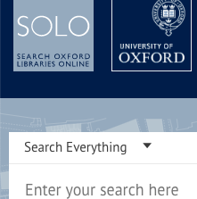
Your SSO
Single
Sign
On
Your username and password to access all online services at Oxford and Hertford.

Slide 3
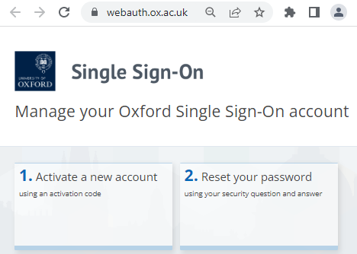
Activation
Once your University Card Form has been returned and processed, you will get an activation email with your:
username hert1234
activation code: xxxxxxxxx.
Go to Web Authentication:
https://webauth.ox.ac.uk/
to set up.

Slide 4
Multi-Factor Authentication
When setting up, you will be asked to verify your SSO account. You might choose:
a text message or phone call
to download the Authenticator app
to download the Authy desktop app.
You will always have to use MFA when using your Oxford account. In case you lose your phone, have a backup – like the desktop Authy app:
https://authy.com/download/.

Slide 5
Problems
The SSO is set up by the central IT Services at Oxford.
Their online guide is at https://help.it.ox.ac.uk/oxford-username-and-sso.

Slide 6
What now?
After set up, you can access many Oxford online services. It’s a good idea to figure out how to use them now, because you will rely on them when you arrive.
Here are some suggestions of things to try…

Slide 7
Things to try:
Check your email and set it up on your devices
https://www.it.ox.ac.uk/use-nexus365-email
Log into SOLO and see if you can locate books and articles https://solo.bodleian.ox.ac.uk/
Download Microsoft Office for free https://help.it.ox.ac.uk/office-365-download

