Slide 1
HOW DO I LOG INTO CANVAS?
Hertford College

Slide 2
Canvas
Website at the University of Oxford, for you to access:
recordings of lectures
course materials
handbooks and exam guides
You need to have activated your SSO (Single Sign-On) to use Canvas.

Slide 3
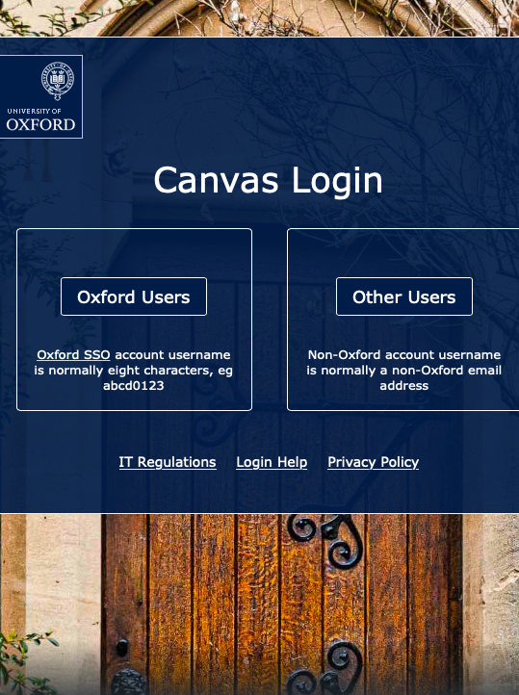
Invitations
At the beginning of term, you will be added to Canvas courses.
Access by clicking the link in an email invitation
or
Go straight to https://www.canvas.ox.ac.uk and accept the invitation there.

Slide 4
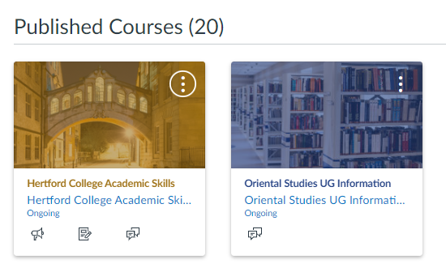
Course cards
You will have a course card for different modules.
All Hertford undergraduates receive a course card for Academic Skills.

Slide 5
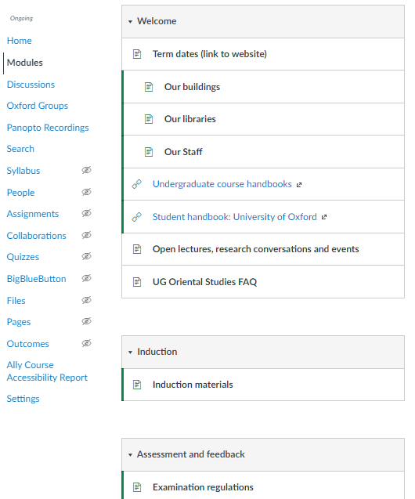
Modules
Each Canvas site stores the course contents under ‘Modules’.
You can return to this page any time by clicking Modules in the Navigation Menu.

Slide 6
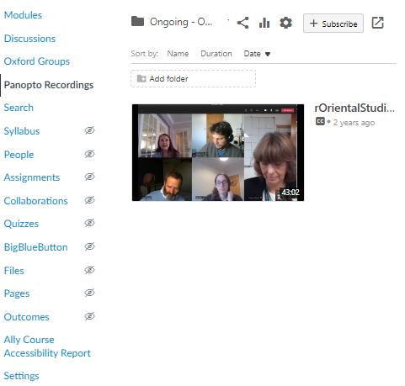
Navigation Menu
The Navigation Menu is organised by content type, such as
files
lectures
interactive quizzes
Clicking Panopto Recordings gives access to recorded lectures.

Slide 7
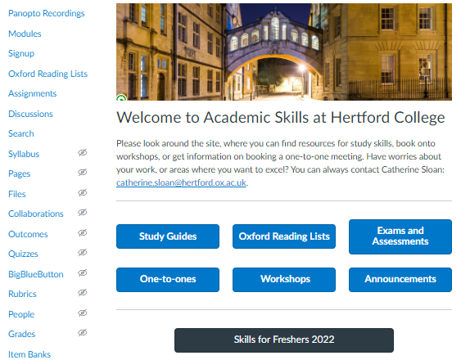
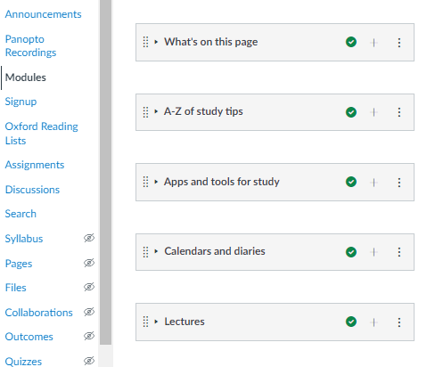
Hertford College Academic Skills
All Hertford students are added to a Canvas for Hertford College Academic Skills. If you do not get access before Week 0, email: catherine.sloan@hertford.ox.ac.uk.

Slide 8
What next?
If you have any problems, visit these links:
https://canvas.ox.ac.uk/courses/21629
https://www.youtube.com/channel/UCZ2_OrSvhKSoJcZtvMvR3Ow
For a guide on downloading the Canvas app to a phone or tablet, visit the link:
https://canvas.ox.ac.uk/courses/21629/pages/canvas-app-for-students

