Slide 1
Science in Context

Slide 2
Get into four groups
Challenge: As a group, write down the names of as many scientists as you can. You have five minutes.
Scoring:
2 points per scientist
3 bonus points if that scientist was not named by anyone else

Slide 3
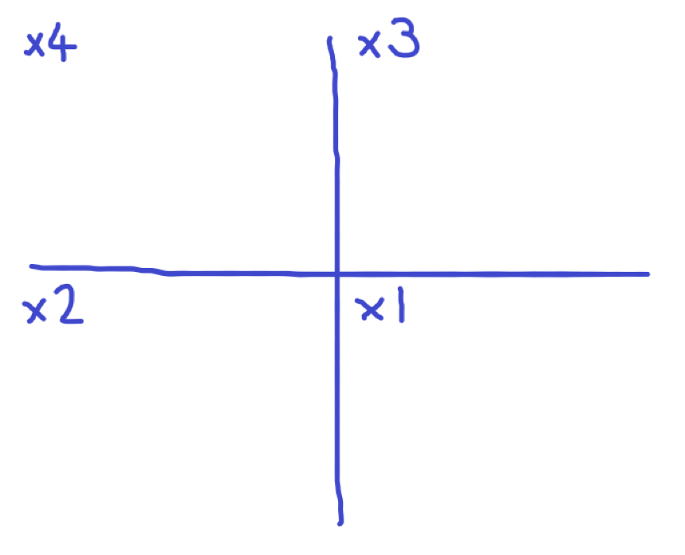
Scientists named by all four groups
Scientists named by just three groups
Scientists named by just two groups
Scientists named by just one group

Slide 4
Look at the scientists named by just one group
Who are they? What did they do?
Any patterns?
Scientists named by just one group
Notes:
Look at the scientists in the x1 square (or x2 if necessary). Who are these lesser-known scientists? What did they do?
Briefly research this individually or as a group if it would help

Slide 5
Scientists named by all four groups
Look at the scientists named by all four groups
Can you spot any similarities among them?
Notes:
Can you spot any similarities among the most famous ones?
Are they mostly:
Male?
White?
European / American?

Slide 6
Go to:
www.hertford.ox.ac.uk/unsungscience/videos
and pick a scientist!
Notes:
Go to www.hertford.ox.ac.uk/unsungscience
Choose one video to watch
Watch the video.
You will probably want to make it full screen using the button at the bottom right of the video.
The videos all have subtitles, which you can turn on if you want.

Slide 7
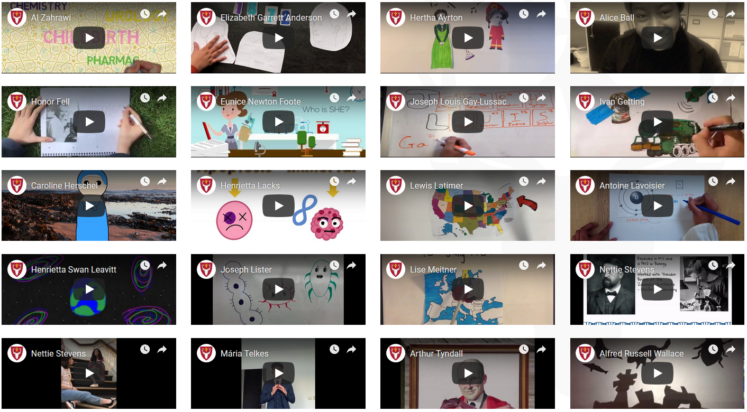

Slide 8
What were the scientist’s achievements?

Slide 9
Would you class them as an ‘unsung hero’?
Why / why not?

Slide 10
Why were / are they unrecognised or under-appreciated?

Slide 11
PICK
ANOTHER
SCIENTIST

Slide 12
Food for thought:
What has changed since these scientists were overlooked?
What hasn’t?

Slide 13
Food for thought:
Does it matter that most of the scientists we learn about in school are “pale, male and stale”, i.e. old, white men?

Slide 14
www.hertford.ox.ac.uk/unsungscience
Notes:
Go to www.hertford.ox.ac.uk/unsungscience
Choose one video to watch
Watch the video.
You will probably want to make it full screen using the button at the bottom right of the video.
The videos all have subtitles, which you can turn on if you want.

