Slide 2
Go to:
https://www.hertford.ox.ac.uk/unsungscience/videos
and pick a scientist!

Slide 3
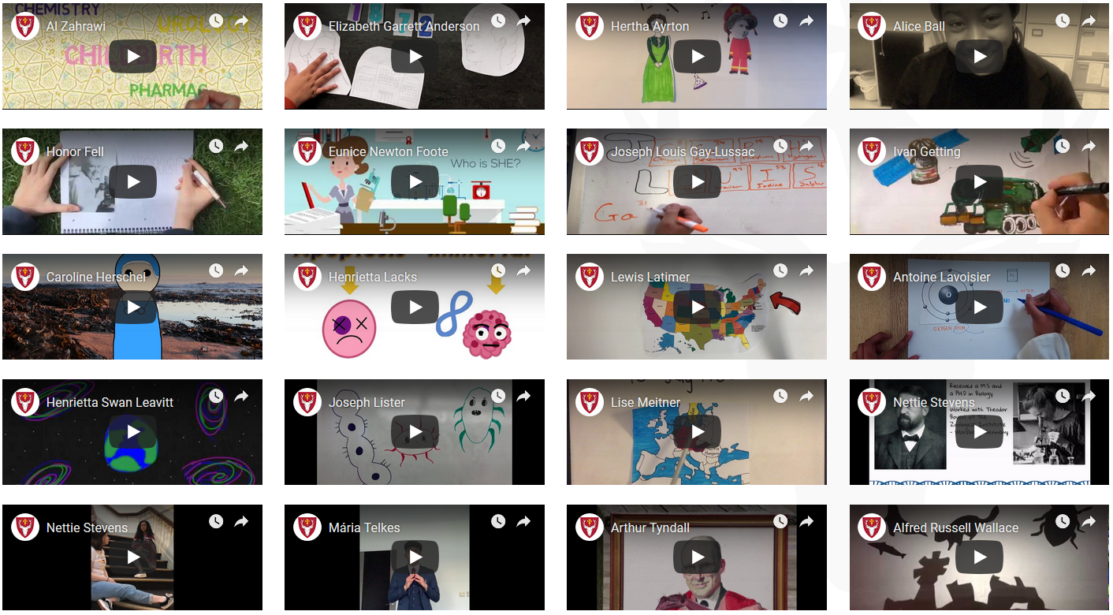

Slide 4
What did you learn from the video?

Slide 5
Reliability
Is this video a good source of information?
Who was it made by? What are its sources? How can you know if it is accurate?

Slide 6
Audience
Who do you think the video is aimed at?
What makes you say that?

Slide 7
Audience
The audience is supposed to be 12-13-year-olds. Do you think the video is suitable for them?
Why / why not?

Slide 8
Videography
What did you like about the video?
How would you improve the video?
Audio? Visuals? Effects?
Storyline? Is there anything they missed? Is there anything you’d skip?
Tone?

Slide 9
Food for thought:
Imagine you are a film producer and someone sent you this as a proposal for a feature film biopic. Would you commission the film? Why / why not?

